Slide 1
Titration Curves
Volumetric Analysis

Slide 2
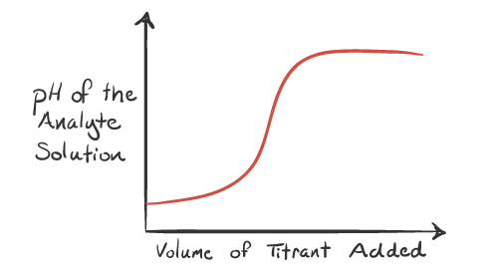
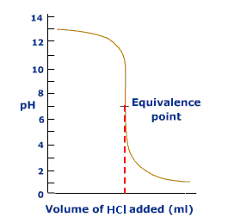
What is a titration curve?
A titration curve is the plot of the pH of the analyte solution versus the volume of the titrant added as the titration progresses.

Slide 3
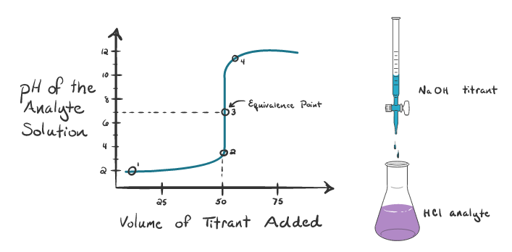
Titration of a strong acid with a strong base
Suppose our analyte is hydrochloric acid HCl (strong acid) and the titrant is sodium hydroxide NaOH (strong base). If we start plotting the pH of the analyte against the volume of NaOH that we are adding from the burette, we will get a titration curve as shown below.

Slide 4
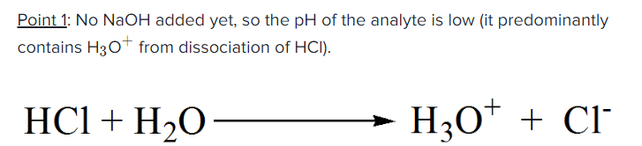
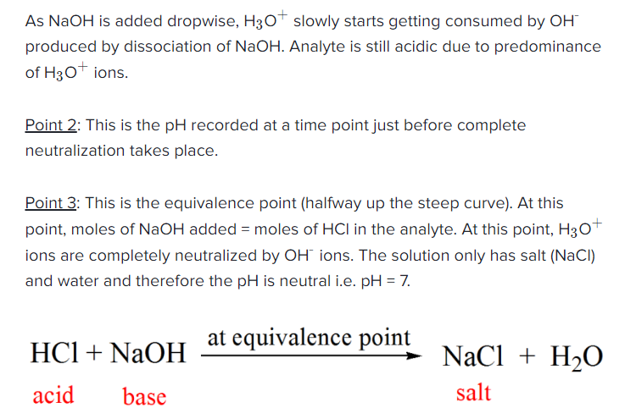

Slide 5
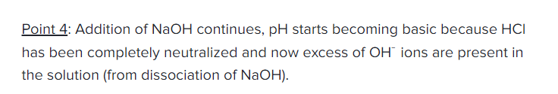

Slide 6
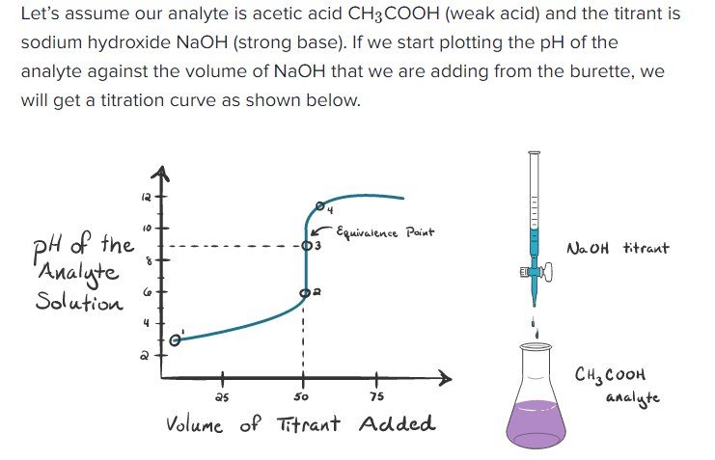
Titration of a weak acid with a strong base

Slide 7
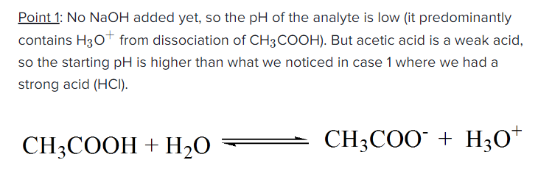
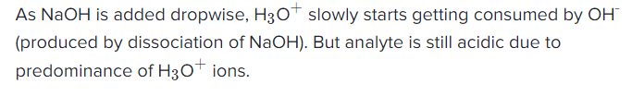

Slide 8
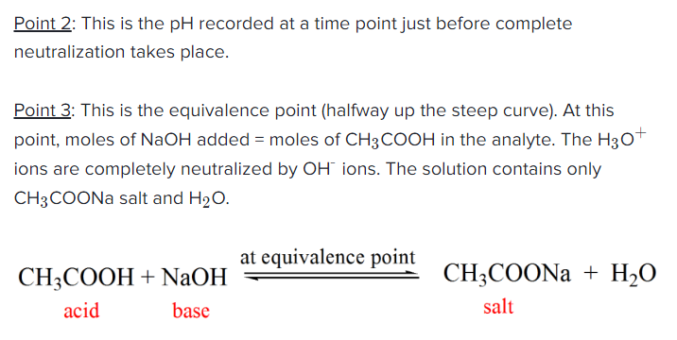

Slide 9
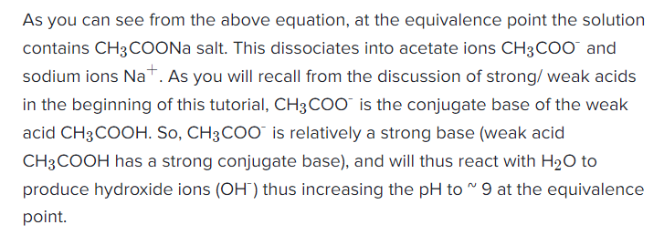
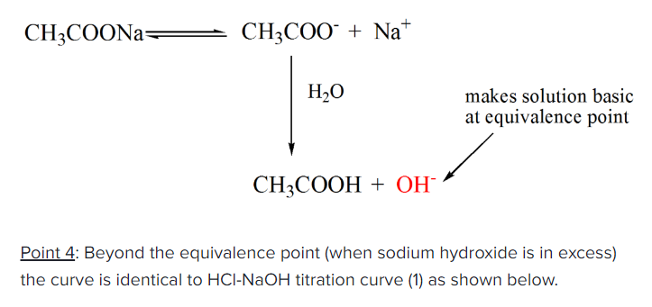

Slide 10
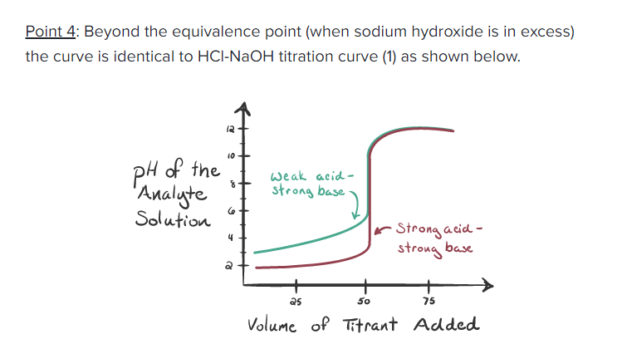

Slide 11
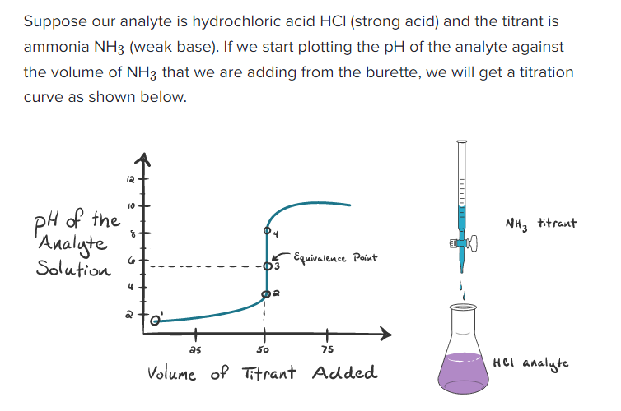
Titration of a strong acid with a weak base

Slide 12
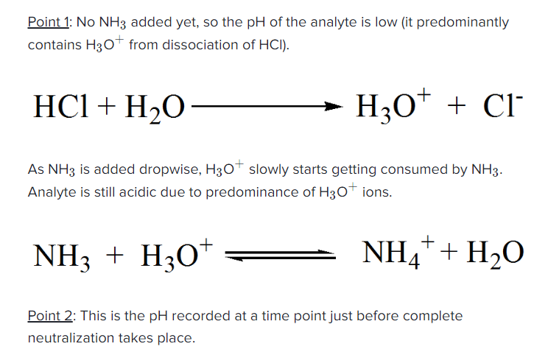

Slide 13
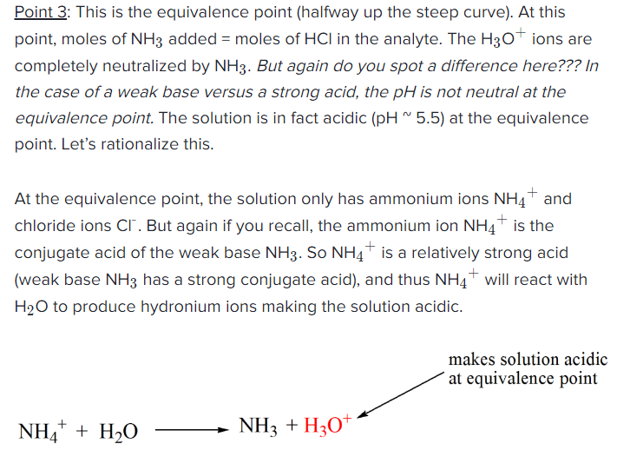

Slide 14
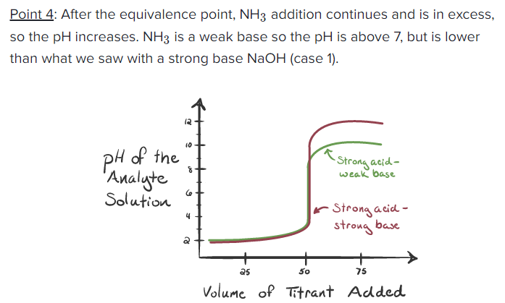

Slide 15
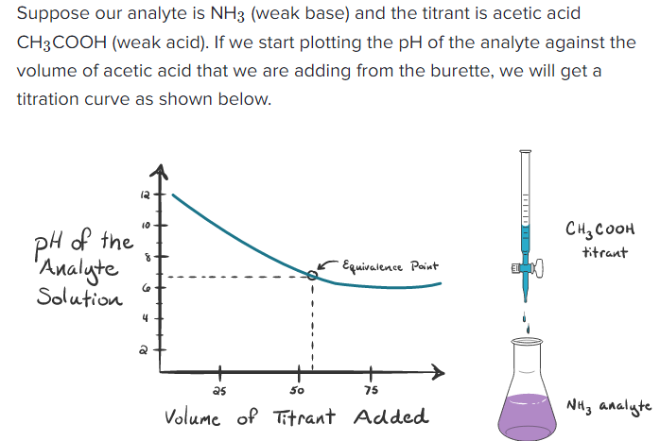
Titration of a weak base with a weak acid

Slide 16
Summary
In an acid-base titration, a known volume of either the acid or the base (of unknown concentration) is placed in a conical flask.
The second reagent (of known concentration) is placed in a burette.
The reagent from the burette is slowly added to the reagent in the conical flask.
A titration curve is a plot showing the change in pH of the solution in the conical flask as the reagent is added from the burette.
A titration curve can be used to determine:
1) The equivalence point of an acid-base reaction (the point at which the amounts of acid and of base are just sufficient to cause complete neutralization).
2) The pH of the solution at equivalence point is dependent on the strength of the acid and strength of the base used in the titration.
-- For strong acid-strong base titration, pH = 7 at equivalence point -- For weak acid-strong base titration, pH > 7 at equivalence point -- For strong acid-weak base titration, pH < 7 at equivalence point

